Slide 1
EHR Coding with Multi-scale Feature Attention and Structured Knowledge Graph Propagation
Source: CIKM”19
Speaker: Tzu-Yun, Chien
Advisor: Jia-Ling, Koh
Date: 2020/03/30

Slide 2
Outline
01
INTRODUCTION
02
METHOD
03
EXPERIMENT
04
CONCLUSION

Slide 3
INTRODUCTION
1

Slide 4
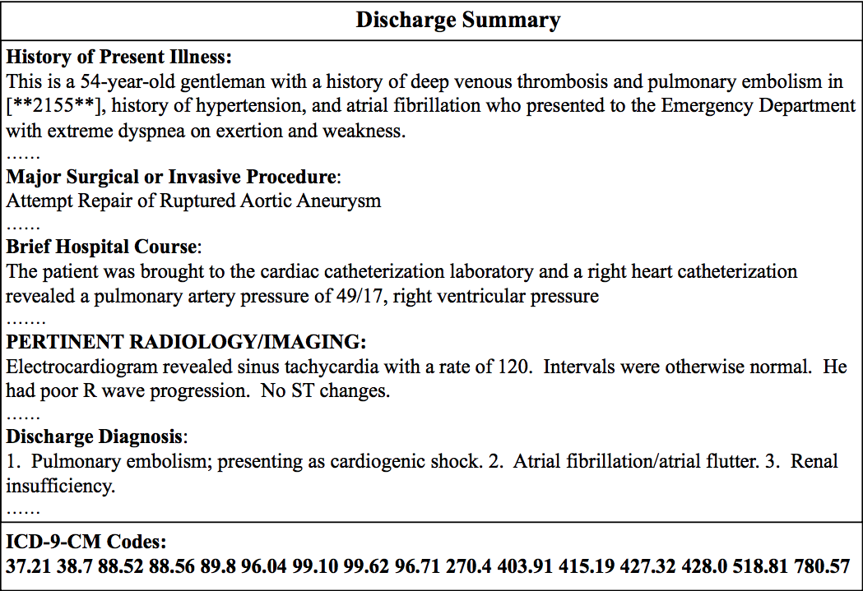
EHR Coding
Input
Output

Slide 5
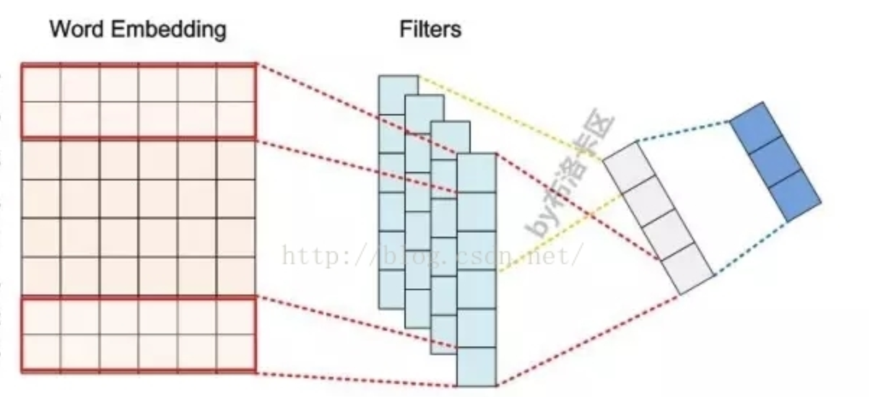
CNN Model
For text classification

Slide 6
CNN Model
For text classification
Example:
Aim: His admission chest x-ray demonstrated prominence of the right main pulmonary artery”
Window size: 1/4
His admission chest x-ray demonstrated prominence of the right main pulmonary artery
-> Inability to adaptively select multi-scale features

Slide 7
The Characteristics of Medical Codes
Hierarchical structure
Nodes close to one with similar semantic embeddings
Example:
proximal pancreatectomy (52.51)
distal pancreatectomy (52.52)
radical subtotal pancreatectomy (52.53)
children
partial pancreatectomy (52.5)

Slide 8
Aim(s)
Use a densely connected convolutional neural network to produce variable n-gram features
Incorporate a multi-scale feature attention to adaptively select multi-scale features
Use graph convolutional neural network to capture both the hierarchical relationships among medical codes and the semantics of each code

Slide 9
METHOD
2

Slide 10
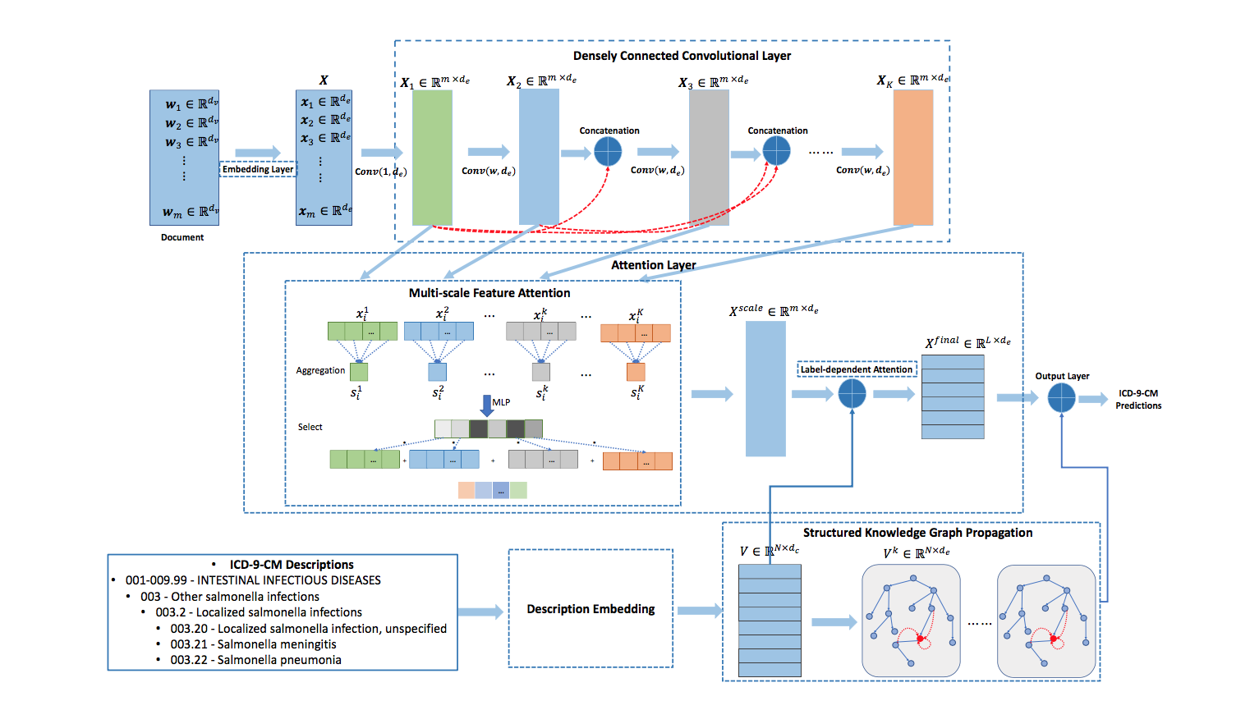
FRAMEWORK

Slide 11
Embedding Layer
Pre-train the embedding layer using CBOW
For each word $w_{m}$ in clinical note,
$$x_{m}= W_{e}w_{m}$$
( m : the length of word sequence of clinical note)

Slide 12
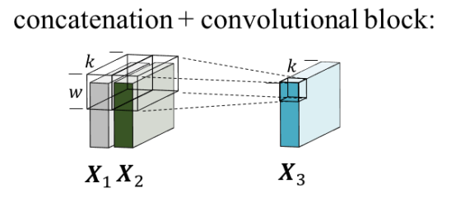
Densely Connected Convolutional Layer
$$1×d_{e}$$
$$X_{k}=F(W_{k},[X_{1},X_{2}{,…,X}_{k−1}]$$
w$×d_{e}$

Slide 13
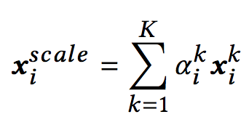
Attention Layer – Multi-scale Feature attention
Aggregation
At each postion $i,$
$$s_{i}^{k}=\sum_{t=1}^{d_{e}}{x_{i}^{k}(t)}$$
Select

Slide 14
Attention Layer – Label-dependent attention
Use description embedding module get ICD-9 code representation $V$.
For each label $l,$
$$α_{l}=softmax{(X}^{scale}v_{l})$$
$$x_{l}^{final}=\sum_{i=1}^{m}{a_{l}^{i}}x_{i}^{scale}$$
$$X^{final}=[x_{1}^{final},x_{2}^{final},…,x_{L}^{final}]$$

Slide 15
Structured Knowledge Graph Propagation
A structured graph with N nodes
(N is the size of all ICD-9-CM codes )
($V^{0}=V$)
($N_{p}, N_{c}=\text{the} \text{index} \text{set} \text{of} \text{the} \text{j}\text{-}\text{th} \text{label}\text{’}\text{s} \text{parents} \text{and} \text{children}$)

Slide 16
Output Layer
For each label $l,$
Loss function
Notes:
the classification layer defined in Eq.8 with binary-cross-entropy loss
the regression layer defined in Eq.9 with mean-square-error

Slide 17
EXPERIMENT
3

Slide 18
Dataset
MIMIC-III
ICD-9 Codes, Discharge summaries
Notes:
Full-label setting, we use all discharge summaries
Top-50 label setting, we only predict 50 most frequent labels, and filter each dataset down to the instances that have at least one of the top 50 most frequent codes

Slide 19
Evaluation metrics
F1-score：$\frac{2×precision×recall}{precision + recall}$
AUC (Area of ROC curve)
p@n (precision at n) ： $\frac{TP}{TP+FP}$

Slide 20
Comparison Baselines
Flat / hierarchical SVMs
LR (Logistic regression)
Selected feature
Bi-GRU
Text-CNN
C-MemNNs
Attentive LSTM
CAML
DR-CAML
LEAM
(joint embedding + cosine similarity)

Slide 21
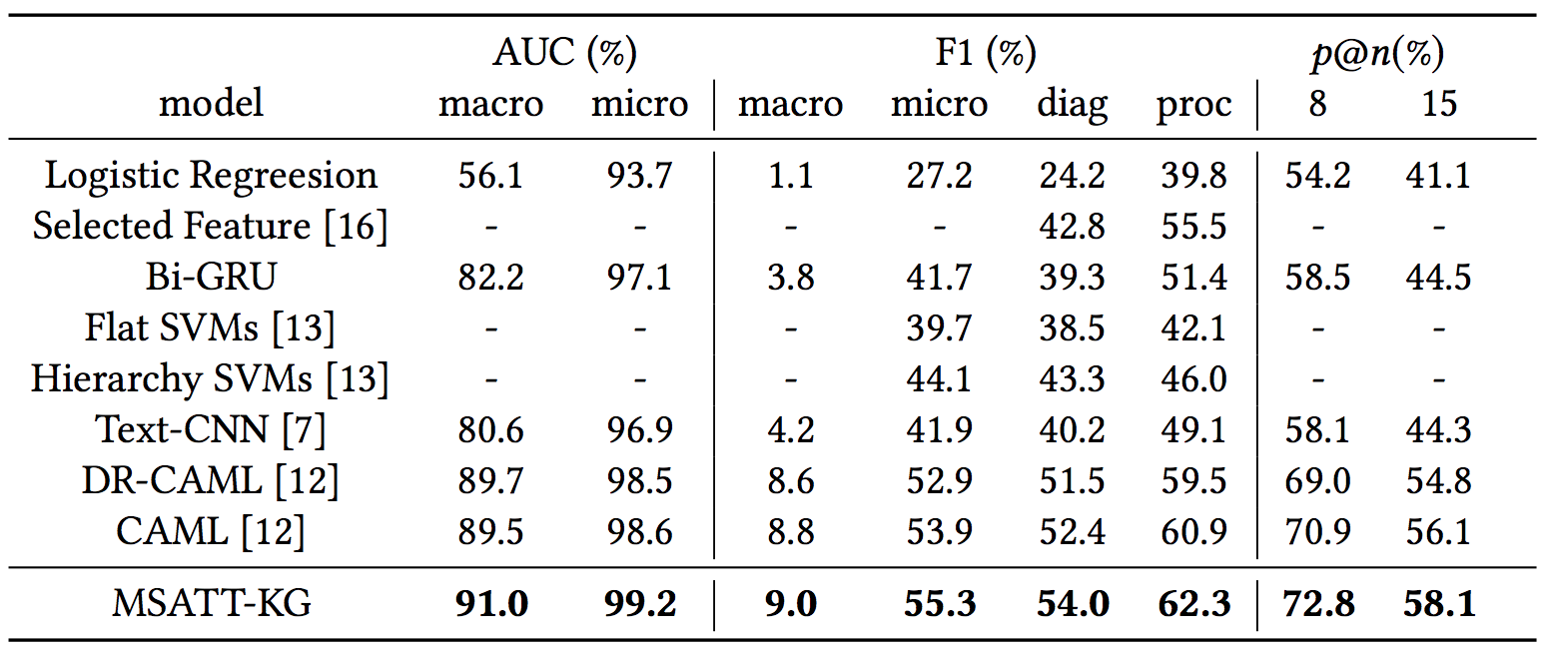
Result(s)- full label set

Slide 22
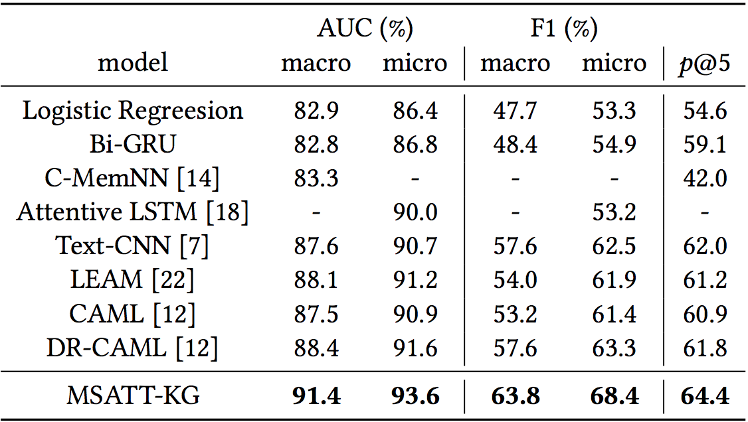
Result(s)- top-50 label set

Slide 23
Interpretability

Slide 24
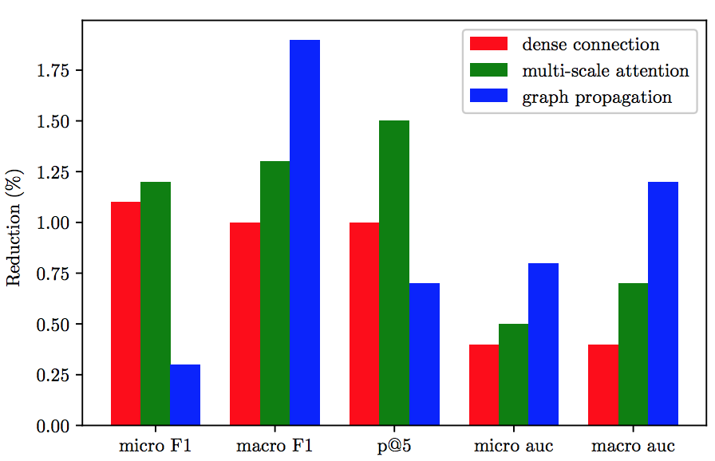
Ablation
the reduction amount of each evaluation

Slide 25
CONCLUSION
4

Slide 26
Conclusion
We utilize a densely connected convolutional neural network for clinical note encoding which can produce variable n-gram features layer by layer.
We incorporate multi-scale feature attention to adaptively select most informative n-gram features.
We leverage graph convolutional neural network to capture the hierarchical relationships among medical codes and the semantics of each code
Following prior works we quantitatively evaluate our approach on real EHR datasets, demonstrating the effectiveness of our proposed method.

